Slide 1
Group 16
John Dorman
Lewis Wilden
River Chick
Guy Zawada
Charlie Kinglake
Roberto Mitrea

Slide 2
Obscure Sorrows

Slide 3
Onism
The frustration of being stuck in just one body that inhabits only one place at a time.
As the game progresses, the player must switch between the two characters more often.

Slide 4
Occhiolism
The awareness of the smallness of your perspective.
The Level will be filled with fog , the level is only visible when using a light source.

Slide 5
Target Audience
Males Aged 16-28

Slide 6
Game Mechanics
Collecting Items
Twitch Movement
Avoiding Obstacles
Puzzle Solving
Switching Between Characters

Slide 7
Game Scope
Levels
Level 1
Level 2
Level 3
Level 4
Level 5
Learn, practise, master loop

Slide 8
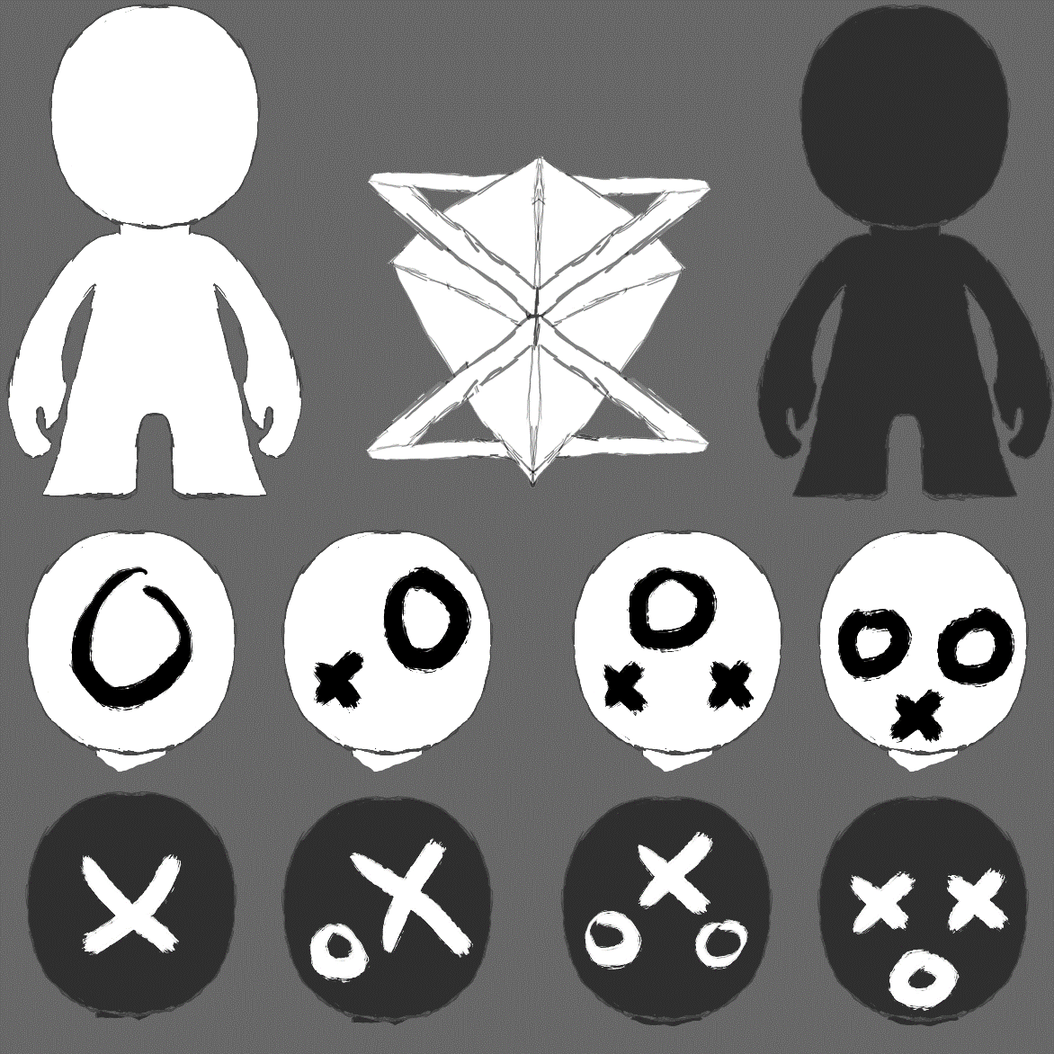
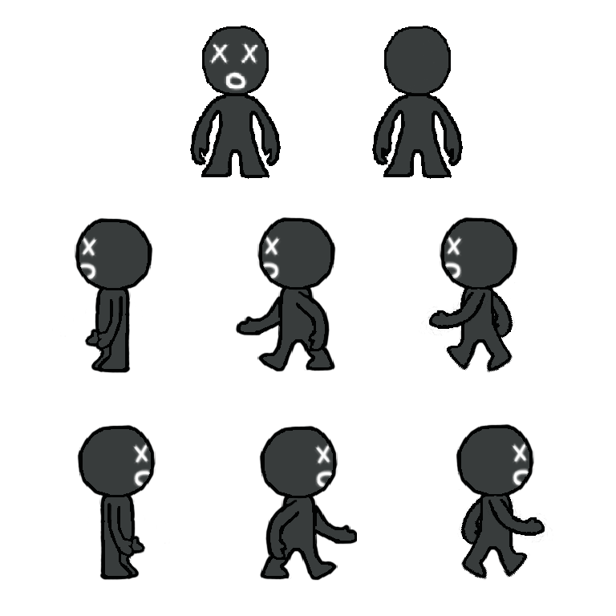
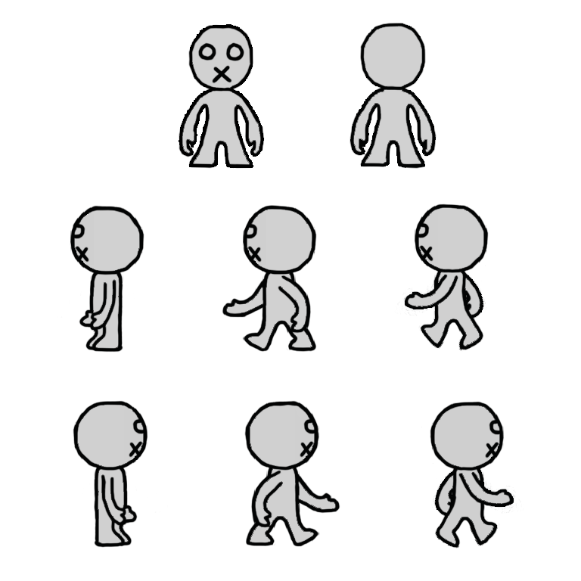
Character Art

Slide 9
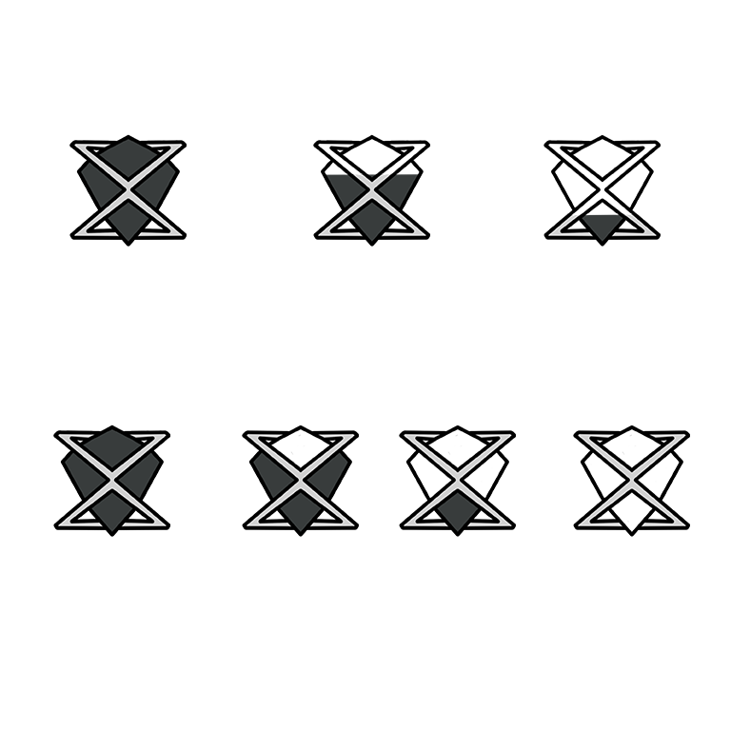
GUI Art

Slide 10
Pressure Plate & Level End Art

Slide 11
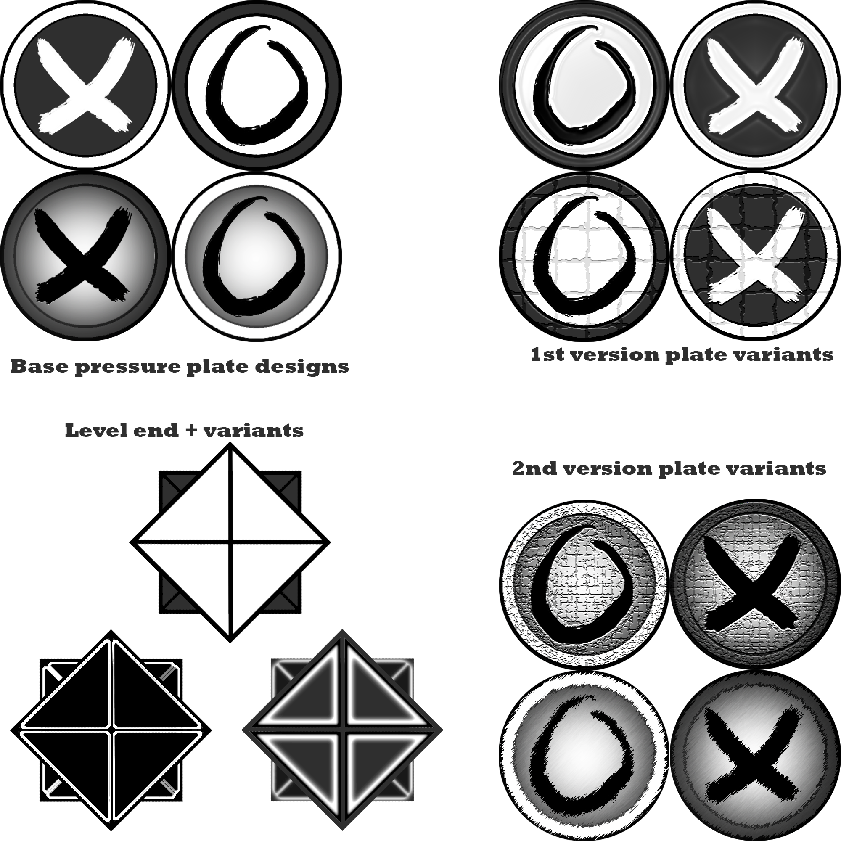

Slide 12
Game Prototype

Slide 13
What Next
Implementing Puzzles
Adding Sprites
Implement The GUI

Slide 14
Questions?

